Slide 1
Reframe
Soft steps towards a better you.

Slide 2
TABLE OF CONTENTS
01
02
03
04
TEAM
PROBLEM
the group behind the project’s success.
The specific issue that motivates this work.
MARKET
SOLUTION
the target audience and context for the solution.
the proposed approach to address the problem.

Slide 3
TABLE OF CONTENTS
05
06
TECHNOLOGIES
Why We’re Different
the technical tools and platforms used.
Why choose us?

Slide 4
MEET ASATIR DIGITAL!

Slide 5
02
PROBLEM
The rise of mental illness and the lack of awarness among students and young professionals.
Home

Slide 6
“You don’t always see the scars, but they are there. Mental health struggles can cloud the brightest mind and weigh the strongest soul.”
—Prince Harry

Slide 7
Let’s get real: STASTICS!
36%
51%
of college students report anxiety
of young professionals reported needing mental health support in the past year

Slide 8
03
market
students and young professionals.
Home

Slide 9

Listen up:STUDENTS & PROS!
Let me tell you about jasser.

Slide 10
USER PERSONA PROFILE
PROFILE
Addiction Statistics
Struggles
50%
Negative self-talk
Difficulty staying motivated
Procrastinating tasks
41%
90%
Jasser represents most of our students and young professionals. Nowadays
How many jassers are among us:
REFORM is jasser’s best chance at becoming the best version of himself
~166 million

Slide 11
04
solutions
Reform is the answers.
Home

Slide 12
“Enough talk: FIXES!”
01
03
02
Turn negative energy into motivation.
see challenges as opportunities
Step In: Bonki needs you!
Therapy Tailored to You
Reframe,Rethink, Recharge
matching our patient to a perfect therapist according to their data
By taking care of ‘Bonkie’ our patient feels seen and theyr’e never lonely any longer they have little ‘Bonkie’

Slide 13
06
technologies
How did we achieve REFORM.
Home

Slide 14



TECHNOLOGIES WE USED
Next.js is a popular React framework used to build production-ready web applications that require strong performance
its strong, open-source performance, friendly commercial license for innovation, wide range of sizes
Use MongoDB for flexible, scalable applications needing to handle diverse, high-volume data with fast development

Slide 15
06
WHAT SETS US APART
WHY REFORM?
Home

Slide 16
What Sets Us Apart
Website | AI Positive Thought Transformation | Therapist Matching | Interactive Game | Motivational Challenges
Reframe
Wysa
Happify
SPARX
Youper

Slide 17
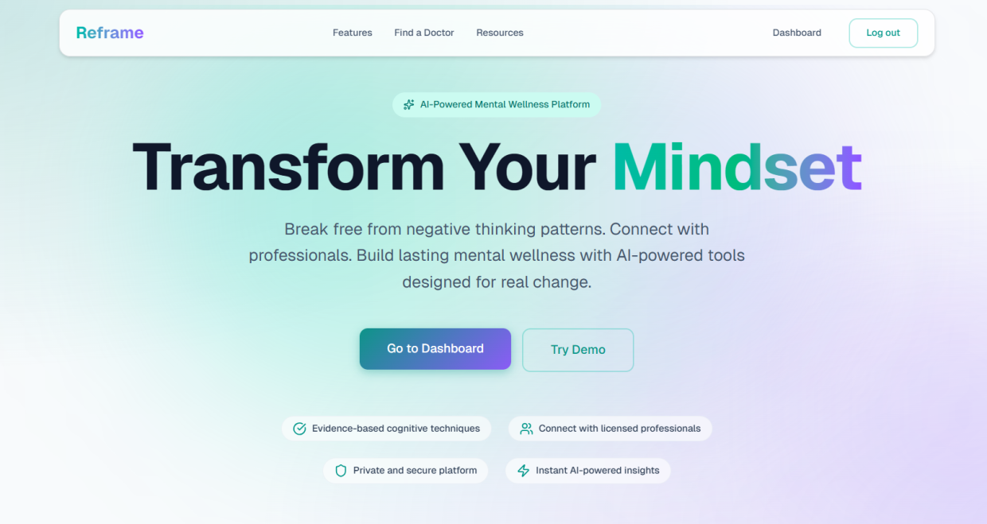
DESKTOP SOFTWARE

Slide 18

THANKS!
Do you have any questions?
nadhirn772@gmail.com
+216 55 193 614
Asatir Digital
Please keep this slide for attribution

